Slide 1


JSPM’s
Rajarshi Shahu College of Engineering, Tathawade, Pune
(An Autonomous Institute affiliated to Savitribai Phule Pune University)
Department of Computer Science and Business Systems
Academic Year: 2026-27
Project Title: DAILY EXPENSE TRACKER
Students Name and PRN no: Aayush Kumar - [RBT25CB045], Ritesh Buchade – [RBT25CB049]
Date: 13-10-2026
Course Name: Database Management System
Course Coordinator: Prof. Rutuja S. Bachhav

Slide 2
Index
Introduction
Problem Definition & Objectives
Literature Survey
Feasibility Study
System Design & Architecture
Database Design & ER Diagram
SQL Implementation & Results
Conclusion
References

Slide 3
Introduction / Background
Definition: Daily Expense Tracker is a web application to record, organize and review daily spending.
Background: Expenses are usually kept in notebooks or spreadsheets, so category totals and budget checks are slow and error-prone.
Approach: A DBMS mini project built with Flask (Python) and MySQL 8 as a two-tier web application.
Motivation: Apply schema design, integrity constraints and SQL queries to an everyday problem.
4
database tables
8
implemented features
2-Tier
Flask web app + MySQL

Slide 4
Problem Definition & Objectives
1
Problem Definition
2
Objectives
Manual tracking makes it hard to see how much is spent in each category.
Comparing monthly spending with a budget needs separate calculations.
Records can be lost, and there is no simple backup.
A simple, database-backed system is needed to store and report expenses.
Record daily expenses (add, edit, delete).
Maintain expense categories.
Manage monthly category-wise budgets.
Compare spending with budget limits.
Store backups in a separate table.

Slide 5
Literature Survey
1
Existing Systems
2
Limitations
3
Gaps Identified
Notebooks and paper records
Spreadsheets
General finance applications
Manual entry causes mistakes.
No integrity rules on the data.
Category totals need manual work.
Records are easy to lose.
No category-wise reports
No backup handling
No simple budget comparison

Slide 6
Feasibility Study
1
Technical
2
Financial / Business
3
Operational
Flask, Python and MySQL 8 are mature and well documented.
mysql-connector-python links Flask to MySQL.
Runs on a normal PC with a web browser.
Every tool used is free or open source.
No licence or hosting cost, as it runs locally.
Tools: MySQL Workbench, VS Code, browser.
Simple HTML forms; no training needed.
Add, edit, delete and backup are one-click actions.
Easy to explain and maintain.

Slide 7
System Design & Architecture
User
Web browser
(HTML forms)
Flask Web Application
Routes + Jinja2 templates
MySQL Database
expense_tracker
Expense Management
Budget Management
Backup
Database
Add, edit, delete expenses
Delete asks confirmation
List shows date, category, amount, note
Monthly category budgets
Report: limit, spent, remaining
Status for each category
Copy expenses to expenses_backup
Each row has backed_up_at
View all backup records
MySQL 8: expense_tracker
4 tables with keys
Foreign key and unique constraints

Slide 8
Database Design & ER Diagram
budgets
categories
expenses
expenses_backup
budget_id (PK)
category_id (FK)
month_year
limit_amount
category_id (PK)
name
expense_id (PK)
amount
category_id (FK)
expense_date
note
expense_id
amount
category_id
expense_date
note
backed_up_at
N:1
1:N
copy
Primary keys: identify every row in the main tables.
Foreign keys: link expenses and budgets to categories.
Unique constraints: avoid duplicate entries.
Backup table: adds backed_up_at to a copy of expense data.

Slide 9
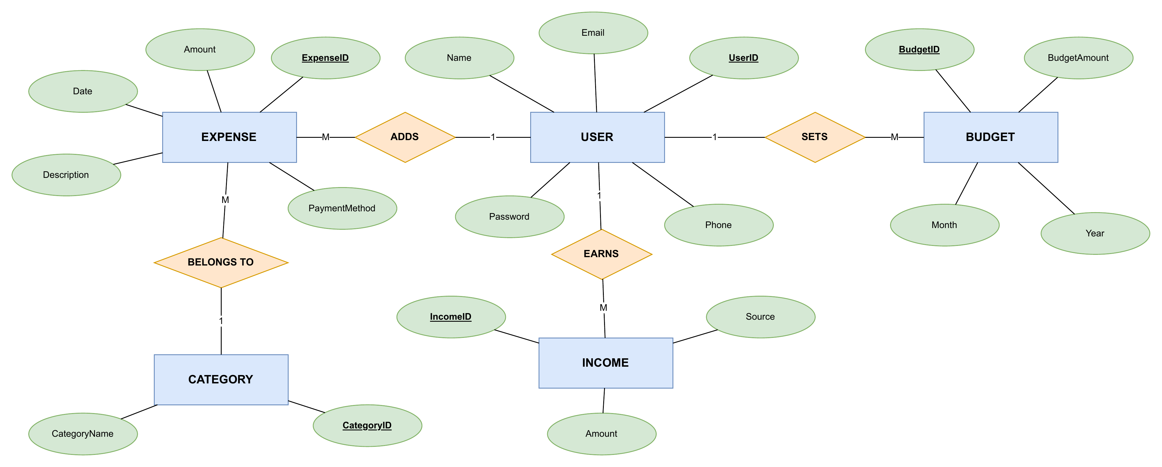
ER Diagram

Slide 10
SQL Implementation – SQL Operations
SQL used in the project
CREATE TABLE expenses (
expense_id INT AUTO_INCREMENT PRIMARY KEY,
amount DECIMAL(10,2) NOT NULL,
category_id INT NOT NULL,
expense_date DATE NOT NULL,
note VARCHAR(255),
FOREIGN KEY (category_id)
REFERENCES categories(category_id)
);
CREATE TABLE
INSERT
SELECT
UPDATE
DELETE
JOIN
GROUP BY and aggregates (SUM)
Foreign and unique constraints
Backup (INSERT … SELECT)
INSERT INTO expenses_backup
(expense_id, amount, category_id,
expense_date, note)
SELECT expense_id, amount, category_id,
expense_date, note
FROM expenses;

Slide 11
SQL Implementation – Workflow & Testing
Start
Open Web Application
Add or Manage Expense
Store Data in MySQL
View Expense and Budget Reports
Create Backup
Function tested | Test performed | Result
Add expense | Submit form with date, category, amount, note | New record appears in the expense list
Edit expense | Change amount or note of a record | Updated values shown in the list
Delete expense | Click delete and confirm | Record removed after confirmation
Budget | Set a monthly limit for a category | Report shows limit, spent, remaining, status
Backup | Run backup, then open backups page | Rows copied to expenses_backup and listed

Slide 12
SQL Implementation – Output Screenshots
[Insert Home Page Screenshot Here]
[Insert Add Expense Page Screenshot Here]
[Insert Edit Expense Page Screenshot Here]
[Insert Budget Page Screenshot Here]
[Insert Backups Page Screenshot Here]
[Insert MySQL Workbench Tables Screenshot Here]

Slide 13
Conclusion
1
Achievements
2
Limitations
3
Future Scope
Add, edit, delete with confirmation.
Monthly category-wise budget report.
Backup table and backup view.
Easier than manual tracking: totals and budget status come from SQL queries.
Works on a local machine only.
No user login.
No charts or export options.
User authentication
Charts and graphs
Export to PDF or Excel
Search and filters
Mobile-friendly design
Online deployment

Slide 14
References
Flask Documentation: https://flask.palletsprojects.com/
MySQL Reference Manual: https://dev.mysql.com/doc/
Python Documentation: https://docs.python.org/3/
MySQL Connector/Python Documentation: https://dev.mysql.com/doc/connector-python/en/
Jinja Documentation: https://jinja.palletsprojects.com/

